Slide 1

Lancashire Healthy Young People and Families Service
School Nursing Team Reception
Presentation

Slide 2


Welcome and Introductions

Slide 3
Who Are We?
The School Health Team are part of Lancashire’s Healthy Young People and Families Service, which is delivered by HCRG Care group.
The School Health team are responsible for delivering the Department of Health recommended Healthy Child Programme.
Our team consists of School Nurses, Community Staff Nurses and Healthy Family Support Workers. We work together to support and improve the health and wellbeing of every child aged 5 to19 years.
We work in partnership with schools, GP’s, Children’s social care and the Children & Families Wellbeing team to support the needs of children, young people and their families.

Slide 4
What We offer to Everyone
Prevention and early intervention
Health Needs Questionnaires in Reception, Year 6 and Year 9.
Signposting to other services
Key health priorities including healthy lifestyles, such as healthy eating and weight
• Health promotion advice and activities
National Child Measurement Programme in Reception and Year 6

Slide 5
We can provide additional support for:
• Emotional health and wellbeing
• Healthy lifestyles
• Bladder and Bowel concerns
Sleep Issues
Behaviour
• Supporting complex and additional health and wellbeing needs
• Transition through services.
Drop-in Clinic in Secondary schools

Slide 6
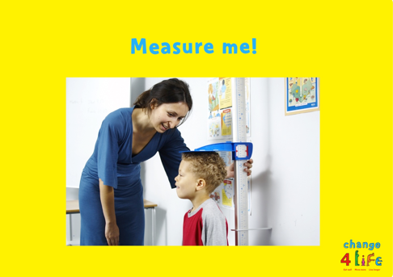

Reception Year Programme
National Child Measurement Programme
Parents and carers will be sent information about the visits that the school nurse makes to the school and permission will be sought for the National Child Measurement Programme when this takes place. The team will deliver the National Health Management Programme in reception and year 6
School Health Needs Assessment
They will also undertake a School Health Needs Assessment questionnaire in reception completed by parents. The purpose of the questionnaire is to identify any additional needs or concerns that may require support from our services, or appropriate signposting to other services
Notes:
Discuss NCMP process
Public Health England (PHE) needs to have a good understanding of how healthy children are, so that the best possible health services and advice can be provided for the children, their families and school communities, where needed.
As a result, a National Child Measurement Programme (NCMP) has been set up, to weigh and measure children, in England, in Reception and Year 6.
Along with PHE the School Nurses will give feedback on how your child is developing and advice on changes you can make to keep them healthy.
SHNA
If you identify any areas of concern the School Nursing Team will be in touch about support or referrals that may be required

Slide 7
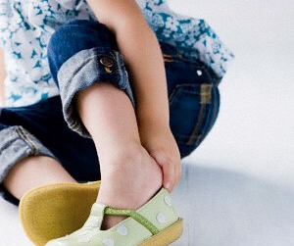


Moving into Primary School, some useful tips:
As your child now moves forward into a Primary School setting, it is a good time to encourage independent skills i.e.
Encourage your child with getting dressed / getting changed independently – (putting coat on, putting shoes on the right feet etc. – (Helps with PE, Break and Home times)
Encourage your child with self-help skills: opening yoghurt pots, lids on drinks etc
Toileting, encourage independence
Notes:
A child’s first day at school, is a big moment for you and for them and it can be both an exciting and nervous time

Slide 8
How to access support from your School Health Team
School are able to complete a referral form to request support from the School Health Team with your consent
OR
Parents can contact our dedicated school nurse duty line Mon-Fri – 9-5pm on 0300 247 0040

Slide 9


Thank you for listening, any Questions ?

Slide 10
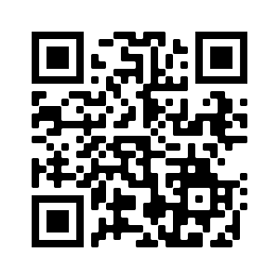
Lancashire Healthy Young Persons and Families Service
Please scan the QR code to go directly to our website for further resources and information.

